Slide 1
Housing and the Financial Sector in the Short and Long Term: Why Are UK House Prices So High?
David Miles
Imperial College
London
June 2017

Slide 5
No growth in average real house prices from 1870-1945; tripling in the next 70 years – source “Global House Prices 1870-2012”, Knoll, Schularick and Stiga, 2014.

Slide 6
Land prices follow similar pattern as house prices source “Global House Prices 1870-2012”, Knoll, Schularick and Stiga, 2014.

Slide 7
But construction costs do not rise as much as land prices or real house prices source “Global House Prices 180-2012”, Knoll, Schularick and Stiga, 2014.

Slide 8
Looking to the very long term…
Suppose population and labour productivity grow at a steady rate in an economy. Can we expect the price of houses to stabilise relative to incomes?
When might the house price to income ratio be falling for long periods ..when rising?
Can we have an ever rising house price to income ratio?
Does that mean an ever declining owner occupation rate?
The answer depends on four – largely unrelated – factors:
Notes:
8

Slide 9
Looking to the very long term
Four factors:
1. technology of producing houses – how are land and structures mixed.
2. preference for housing versus other goods and preferences for different mixes of land and structure in housing
3. the nature of bequests and how wealth is transferred from the old to middle aged and on to the relatively young.
4. The speed with which people can travel further distances to get to work
Notes:
9

Slide 10
Looking to the very long term
Under plausible sets of parameters in a simple long run growth model house prices can rise forever relative to the price of other goods and also rise continually relative to incomes.
The key parameter is the substitutability of land and structures in the production of housing services.
This is a parameter that reflects technology and preferences. It is one that Muth investigated in detail some 40 years ago.
Notes:
10

Slide 11
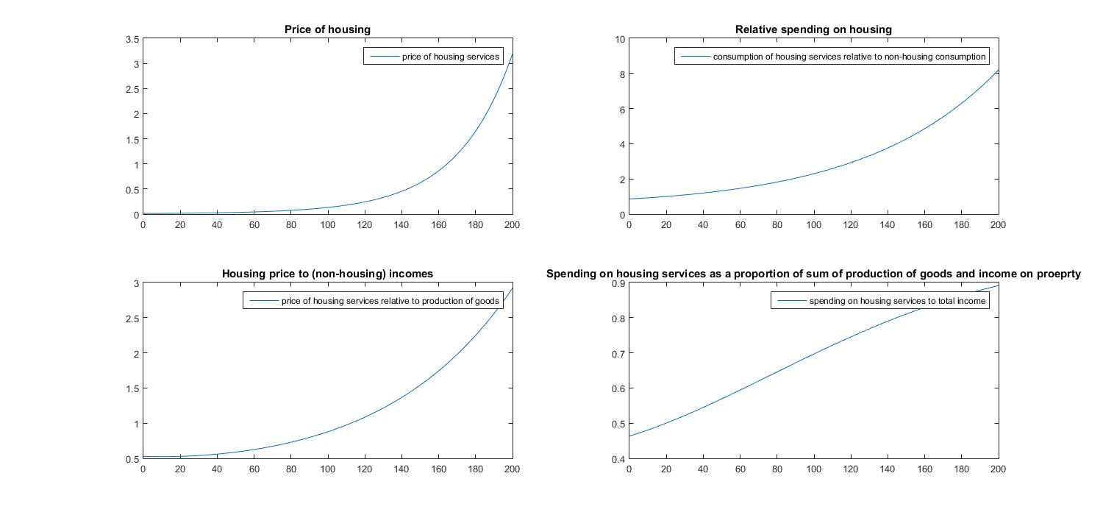
ε = 0.5 average annual house price growth 2.81%, growth in Y 1.90%

Slide 12
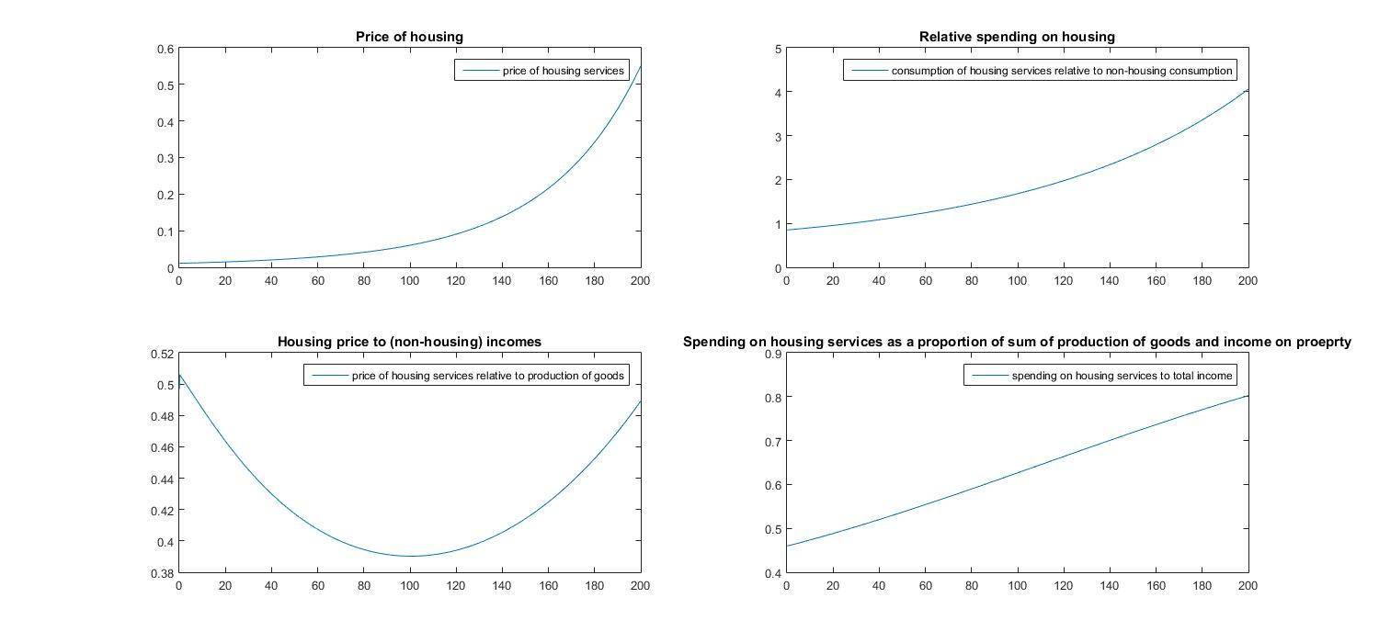
ε = 0.75 average annual house price growth 1.95%, growth in Y 1.90%

Slide 13
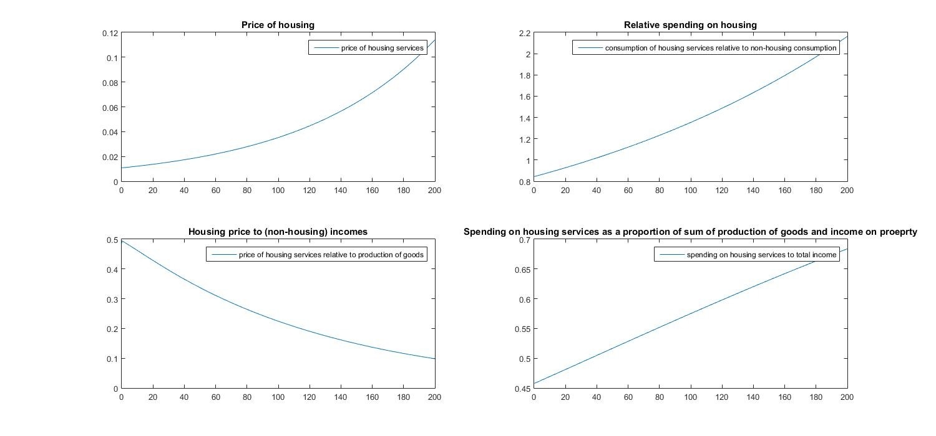
ε = 0.99 average annual house price growth 1.18%, growth in Y 1.90%

Slide 14
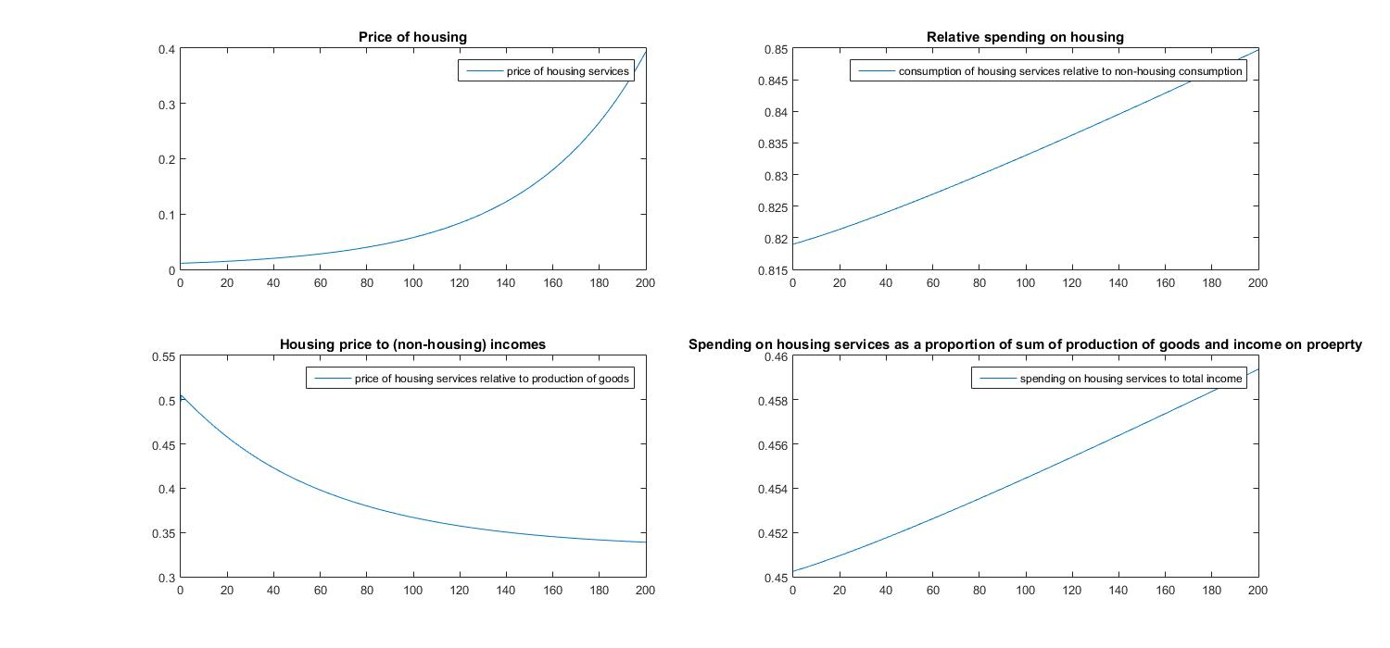
ε = 0.5, ρ=0.99

Slide 15
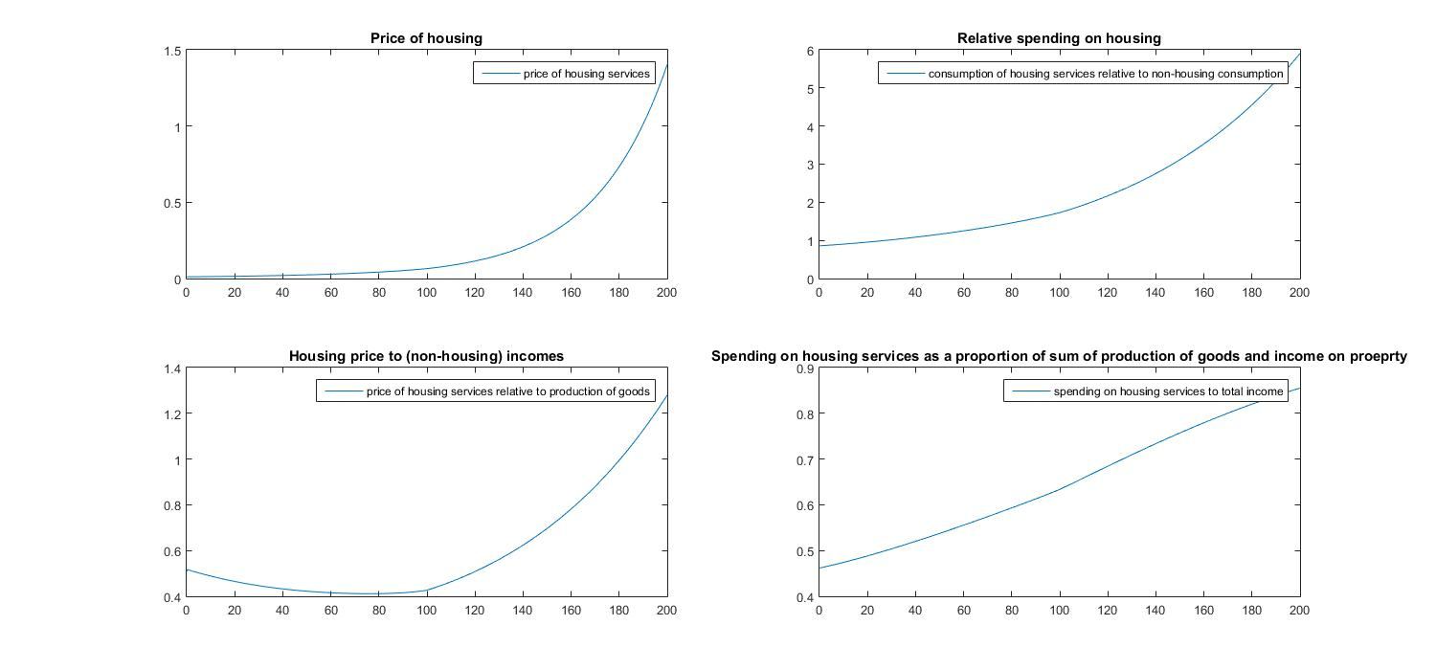
ε = 0.5, ρ=0.6 ; growth in effective land area of 0.5% a year for first 100 years due to transport improvements

Slide 16
Looking to the very long term…
From the NY Times, December 2015:
“As recently as two years ago, only five towers in NYC topped 1,000 feet. Now, there are that many “supertall” towers in the works on 57th Street alone, and roughly two dozen either under construction or on the drawing boards across Manhattan and in Brooklyn.
These slender cloud-busters would not have been built without the confluence of new technologies…. Superstrong concrete and new wind testing made possible buildings like 432 Park, which, at 93 feet wide, is 15 times as tall as it is wide.
In effect, developers now need only a lot the size of a brownstone or three to build a tower, rather than much of a block, as with the 1,250-foot Empire State Building, which, when it opened in 1931, was the tallest building in the world.”
http://nyti.ms/1OjcE9l
Notes:
16

Slide 17
Looking to the very long term…
Suppose house price to income ratio keeps on rising. But people can only borrow 90% of a house. Then it takes ever longer to buy.
Does the owner occupation ratio fall consistently?
What about bequests?
What does a society with 90% renting look like? This is Britain in 1914.
BUT: the houses would probably be owned much more equally – indirectly in savings vehicles owned quite widely.
There is no reason why a country with a low owner occupation rate has to be one with very unequal ownership of wealth.
Moves to make supplying rental properties penalised (such as are now being implemented) are very unlikely to help the young.
Notes:
17

Slide 18
Conclusions
Plausible parameter estimates plugged into a simple growth model can easily generate ever rising house prices – relative to other goods AND to incomes.
But there is great sensitivity to parameters that reflect both preferences (between different characteristics of houses) and technology.
The key technology factor is how one combines structures and land to create housing. That has changed …see the New York and London skylines.
But can it make people willing to substitute away from using land and be compensated for by having fancy buildings?
Notes:
18

Slide 19
Conclusions
Housing over the long term could become increasingly expensive and increasingly rented.
That would be more likely if:
A. population and productivity both grow steadily
B. people are increasingly unwilling to live high in the sky or even underground – which will limit the scope to economise on land use.
C. people do not substitute much away from spending money on houses and divert it to other consumption as house prices rise.
D there is no improvement in travel times.
Those conditions probably all hold in the UK. But massive investment in transport infrastructure could mean future price rises can be limited…….
Notes:
19

